Slide 1

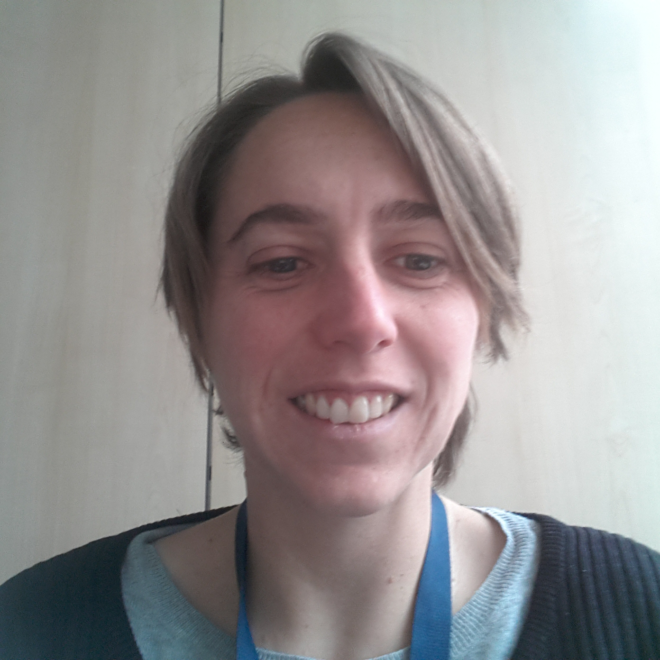




DEVELOPMENT OF AN EXPERIMENTAL SETUP FOR SAFETY ASSESSMENTS OF NEW ULTRASOUND IMAGING MODES
Adeline Bernard¹,
Hervé Liebgott¹,
Pauline Muleki-Seya¹,
Lorena Petrusca¹,
Emmanuel Roux¹,
Matthieu Toulemonde²,
François Varray¹,
Didier Vray¹,
This material is based upon work done on the PILoT facility
(PILoT, INSA LYON, Bât. Blaise Pascal, 7 Av. Jean Capelle 69621 Villeurbanne)
¹ Univ Lyon, CREATIS, France
² Department of Bioengineering, Imperial College London, United Kingdom
Notes:
La première diapo fait très chargée ? Puis-je enlever ou diminuer certains logos ?
Penser à ajouter se photo si pas de webcam

Slide 2
INTRODUCTION - BACKGROUND
Ultrasound medical imaging: Affordable – Real-time / fast imaging – spatial resolution – safety
Open platforms available to research [1] (Verasonics, Ula-Op, …)
Development of new imaging techniques [2] (unfocused, ultrafast, 3D, …)
In vivo acquisition ?
MI (Mechanical Index)
ISPTA (Intensity Spatial Peak Temporal Average) and TI (Thermal Index)
Prove that the whole acquisition platform (ultrasound scanner, probes and imaging sequences) is safe and is compliant with safety regulations
[1] E. Boni, et al. ‘Ultrasound Open Platforms for Next-Generation Imaging Technique Development’, IEEE Trans. Ultrason. Ferroelectr. Freq. Control, 2018,
[2] M. Tanter and M. Fink, ‘Ultrafast imaging in biomedical ultrasound’, IEEE Trans. Ultrason. Ferroelectr. Freq. Control, 2014
Notes:
Idea ?

Slide 3
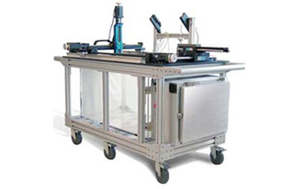
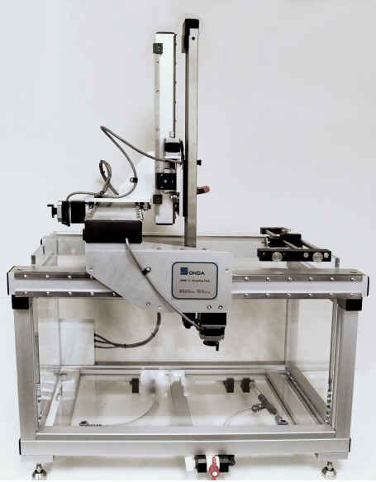
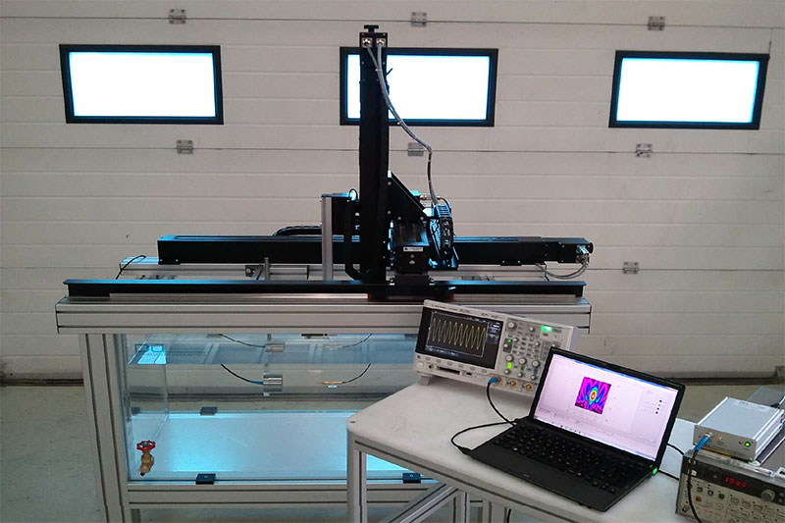
INTRODUCTION – COMMERCIAL SOLUTIONS
Company | ACERTARA, USA | ONDA CORPORATION, USA | PRECISION ACOUSTIC, UK
Model | AMT | AIM III | UMS3
Image
Cost in k€ (date of quotation) | 48 (2020) | 57 (2020) | 46 (2018)
Automatic calculations | Gold standard | ISPTA, pulse duration, MI (derated value) | ISPTA, pulse duration, MI + others
Regulatory requirements | NEMA UD2 and others | FDA 510(k) | FDA 510(k), NEMA UD2 and others

Slide 4
INTRODUCTION – COMMERCIAL SOLUTIONS
Company | ACERTARA, USA | ONDA CORPORATION, USA | PRECISION ACOUSTIC, UK
Model | AMT | AIM III | UMS3
Minimum step size in µm | Between 0.198 and 1.25 | 5.5 | 1
Dimension of travel : X x Y x Z in cm | Not found* | 38 x 26,5 x 33 | 30 x 30 x 30
Options | Integrated Thermocouple | Temperature Probe, rotational axes, water conditionning system | rotational axes, water conditionning system
Programming language | Access to the source code possible | External Control via Ethernet or Librairies | Labview + source code for developments
These commercial solutions may not well adapted for new specific ultrasound imaging modes developed in research, for example, for 2D and 3D unfocused imaging.
* This information do not be found on website and datasheet of the product.
Notes:
Expliquer le not found ?

Slide 5
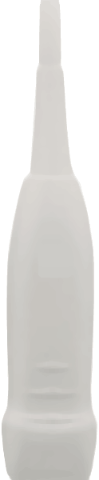
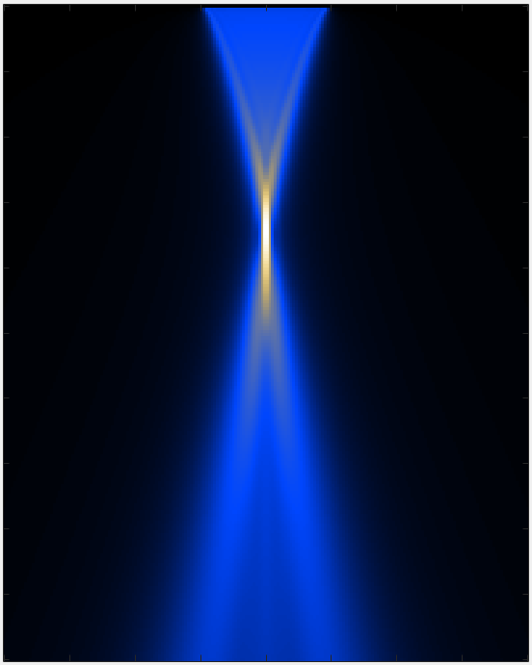
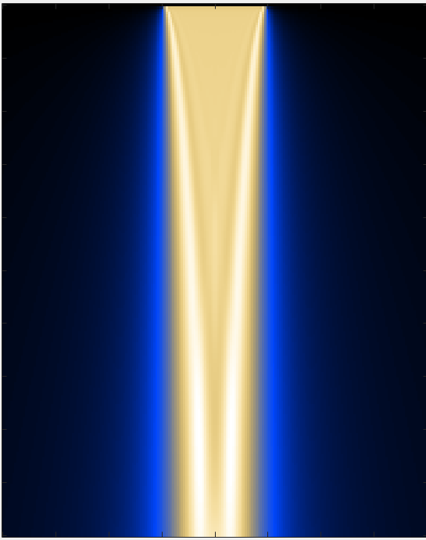
INTRODUCTION – PROBLEM
Focused Imaging
Plane wave Imaging
Diagram / simulation [3]
Maximum pressure at the depth of focalization
Medium insonify more uniformly
Pressure field obtained with our setup [4]
[3] S. Shahriari and al, ‘Meshfree simulations of ultrasound vector flow imaging using smoothed particle hydrodynamics’, Phys. Med. Biol., Oct. 2018
[4] M. Toulemonde, ‘Formation de voies en émission et en réception pour l’amélioration de l’imagerie ultrasonore : application à l’imagerie non linéaire des tissus biologiques’, thesis, 2014
Notes:
Est-ce un problème si les références n’apparaissent pas dans le même ordre que dans le proceeding ?

Slide 6
INTRODUCTION – PROPOSED SOLUTION
Commercial platforms: available with customization possibilities
Proposal: our own pressure field measurement platform
Perfect control over all possible measurements and calculations.
Continuously improve our setup according to new standards / requirements.

Slide 7
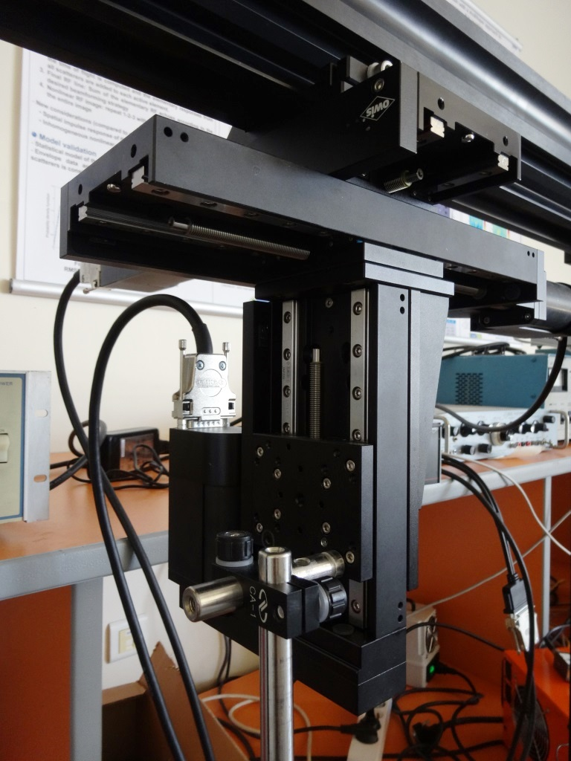
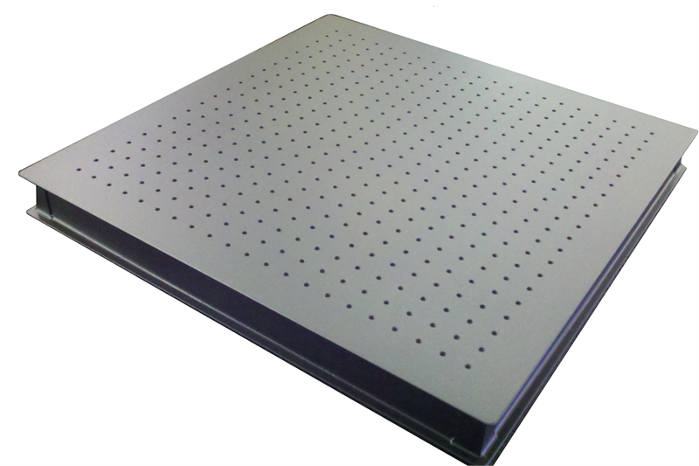
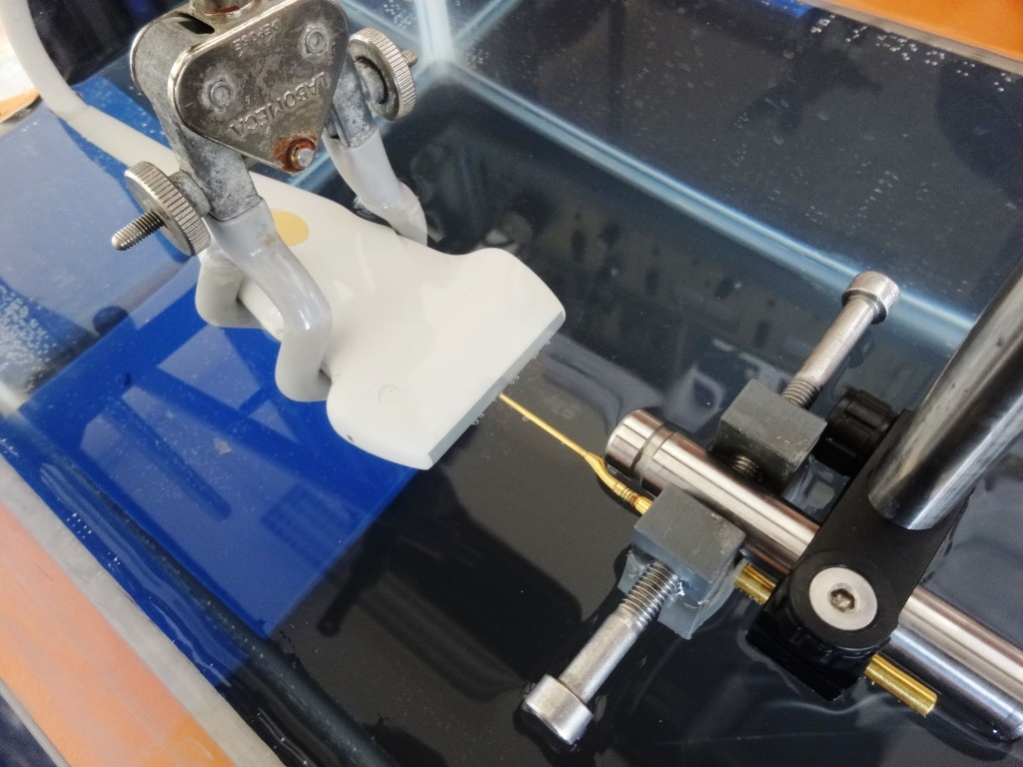
MATERIALS AND METHOD - DESCRIPTION OF THE EXPERIMENTAL SETUP
X
DC motor-driven translation (Owis, Germany) :
Length X and Z : 95 mm, Y : 195 mm
Accuracy : 1,25 µm
Y
Z
Three 750 mm profiles mounted in an inverted U-shape and mounting accessories
Controller 3 axis with software and DLL
A solid bench we already have
An optical breadboard of 1000 x 400 x 33 mm, weight : 32 kg
About 10 k€ in 2013

Slide 8
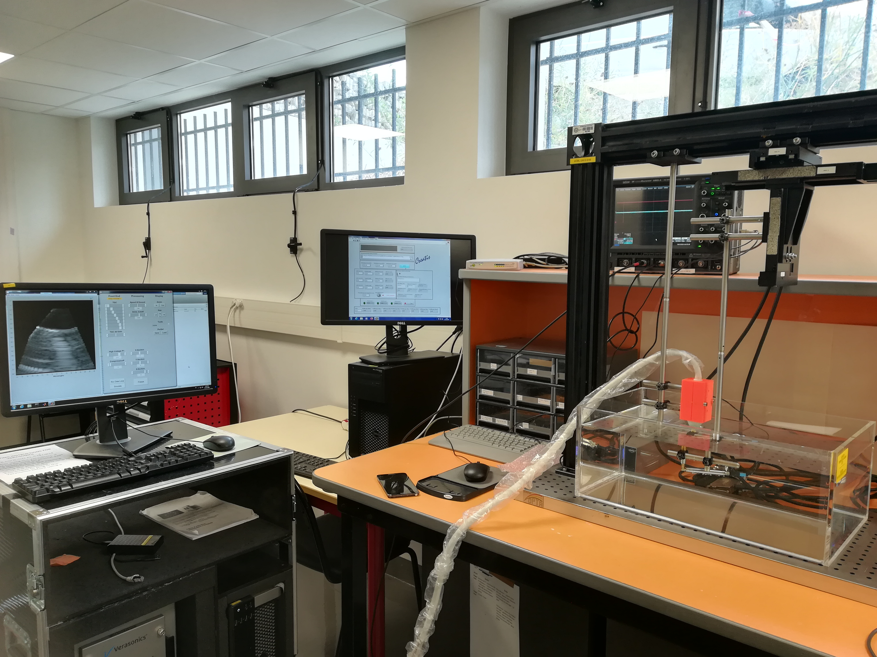
MATERIALS AND METHOD – PICTURE OF OUR SETUP
Oscillopscope
Software
SETUP
Open ultrasound scanner Vantage 256 (Verasonics, USA)
Water tank with probe and hydrophone

Slide 9
MATERIALS AND METHOD - COMPARISON OF OUR EXPERIMENTAL SETUP WITH COMMERCIAL SOLUTIONS
 | Our setup | Synthesis of commercial solutions
Architecture | Composed of several parts | One block
Price without options (k€) | 10 (in 2013) | 50 (in average, quotation in 2018-2020)
Automatic calculation of safety indexes | ISPTA, MI and TI | ISPTA, pulse duration, MI + others
Regulatory requirements | IEC60601-2-37 [5], IEC61102 [6] | IEC60601-2-37 + others
Minimum step size in µm | 1.25 | Between 0.198 and 5.5
Dimension of the travel: X x Y x Z in cm | 9.5 x 19.5 x 9.5 | 34 x 28 x 32
Programming language | Labview and Matlab | Customization possibilities
Options | Possible to add | Temperature Probe, rotational axes, water conditionning system
[5] ‘IEC 60601-2-37:2004 Medical electrical equipment – Part 2-37: Particular requirements for the safety of ultrasonic medical diagnostic and monitoring equipment’. International Electrotechnical Commission Edition 1:2001,
[6] I. E. Commission, ‘Measurement and characterization of ultrasonic fields using hydrophones in the frequency range 0.5 MHz to 15 MHz’. IEC, 1991

Slide 10
MATERIALS AND METHOD – PROCEDURE ACCORDING TO STANDARDS
For non scanning application
Step 1: beam axis
Acquire three 1D scans in the lateral dimension at three depths to find the axis of the ultrasound beam.
Step 2: ISPTA and depth Z3
Calculate ISPTA along the beam axis.
Find the depth Z3 corresponds to the maximum ISPTA.
Step 3: MI
Calculate MI at depth Z3.
Step 5: Measurement and calculation of the sound power level P3
Acquire a 2D scan at depth Zbp.
Integrate intensities to obtain power P.
Calculate power P3 as a function of the depth.
Step 4: Beam exit area
Acquire 1D scan in lateral and elevation.
Calculate an area and an associated depth Zbp.
Step 6 : TI calculation
Calculate TI as a function of P3.

Slide 11
MATERIALS AND METHOD – DATA ACQUISITION
Acquisition of the complete pressure field
Pressure field of a plane wave sequence in MPa
Dimension | Length (mm) | Step (mm)
Axial | 45 | 0.5
Lateral | 46 | 0.5
Elevation | 1 | 1
Plane wave sequence with a Vantage 256 (Verasonics, USA) and a linear probe L7-4 :
Frequency | Number of cycle | Voltage | Frame rate
5.2 MHz | 1 | 50 V | 500 Hz

Slide 12
RESULTS – SAFETY INDEX
 | Standard (non scanning procedure) | Complete Field
ISPTA in mW/cm² | 44 | 47
MI | 1.1 | 0.8
TIS / TIB | 0.1/ 0.5
Thresholds given by the FDA regulation [7] for the peripheral vessels:
ISPTA < 720 mW/ cm²
MI < 1.9
[7] U. S. Food and D. Administration, ‘Information for manufacturers seeking marketing clearance of diagnostic ultrasound systems and transducers’, Rockv. MD Cent. Devices Radiol. Health US Food Drug Adm., 2008.

Slide 13
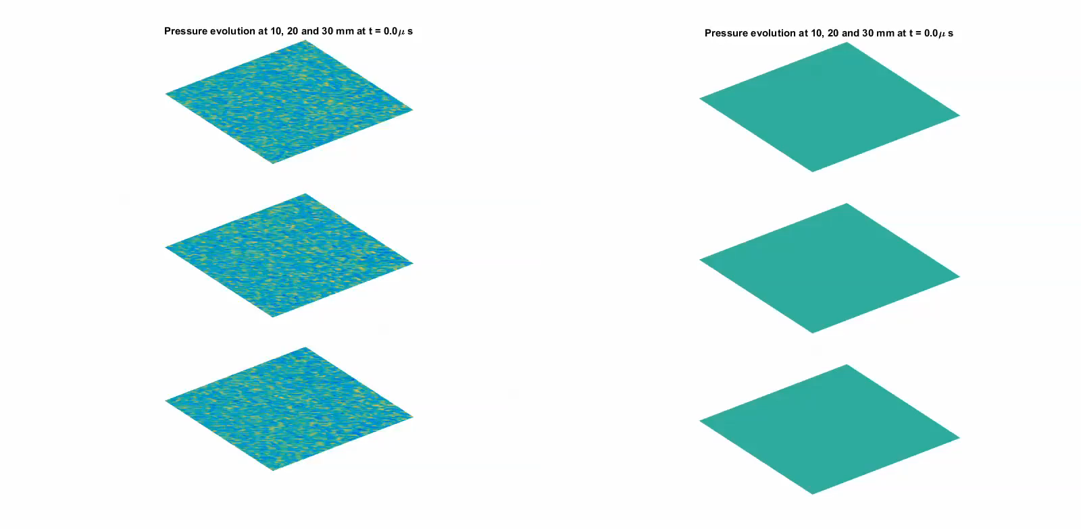
RESULTS – 3D IMAGING
Acquisition of the pressure field at three depths : 10, 20 and 30 mm
One shoot with the central element of a matrix probe 32 x 32 elements (Vermon, France) with a Vantage 256 (Verasonics, USA) :
Dimension | Lenght (mm) | Step (mm)
Lateral and elevation | from -10.2 to +10.2 | 0.3 (pitch)
Frequency (MHz) | Number of cycle
3 | 4
[8] E. Roux, ‘2D sparse array optimization and operating strategy for real-time 3D ultrasound imaging’, thesis, 2016.

Slide 14


DISCUSSION AND CONCLUSION
A working, open and flexible safety measurement platform
Next steps :
Technological aspect: Add a water conditioner.
Methodological aspect: Decrease the acquisition time vs Increase the resolution.
Regulatory aspect: Consider other standards
Notes:
https://obsproject.com/fr/download

Slide 15


THANK YOU FOR YOUR ATTENTION
ANY QUESTIONS ?
This work was performed within the framework of the LABEX CELYA (ANR-10-LABX-0060) and the LABEX PRIMES (ANR-11-LABX-0063) of Université de Lyon, within the program "Investissements d'Avenir" (ANR-11-IDEX-0007) operated by the French National Research Agency (ANR)

Slide 16
More results - MI
Method | Standard / en prenant en compte l’erreur de l’hydrophone | Complete field
MI | 0,75* / 0,844 | 0,81
Elevation position | 5th plan / idem | 5th plan
Axial position | 21 mm / idem | 23,5 mm
Lateral position | -1 mm /idem | -16,5 mm
Min pressure (along the beam axis) | -2,28 Mpa at 24 mm depth / -2,55 Mpa at 24 mm depth | -2,5 Mpa
Min pressure at z3 | -2,19 Mpa / -2,46 MPa | Not concerned
*Error on the proceeding

Slide 17
More results - ISPTA
Method | Standard / en prenant en compte l’erreur de l’hydrophone/ en prenant en compte la température de l’eau et donc la vitesse et la densité | Complete field
ISPTA mW/cm² | 44,4 / 56,0 / 58,46 | 47,3
Elevation position | 5th plan / idem | 5th plan
Axial position | 21 mm (=z3) / idem | 20 mm
Lateral position | -1 mm / idem | -5,5 mm
Pressure corresponding to the max ISPTA | 4,5 Mpa (along the beam axis and at z3) / 5,07 MPa | 5,2 Mpa
Max pressure | Idem like ISPTA / idem | 5,5 Mpa at 21 mm depth and -5,5 mm in lateral

Slide 18
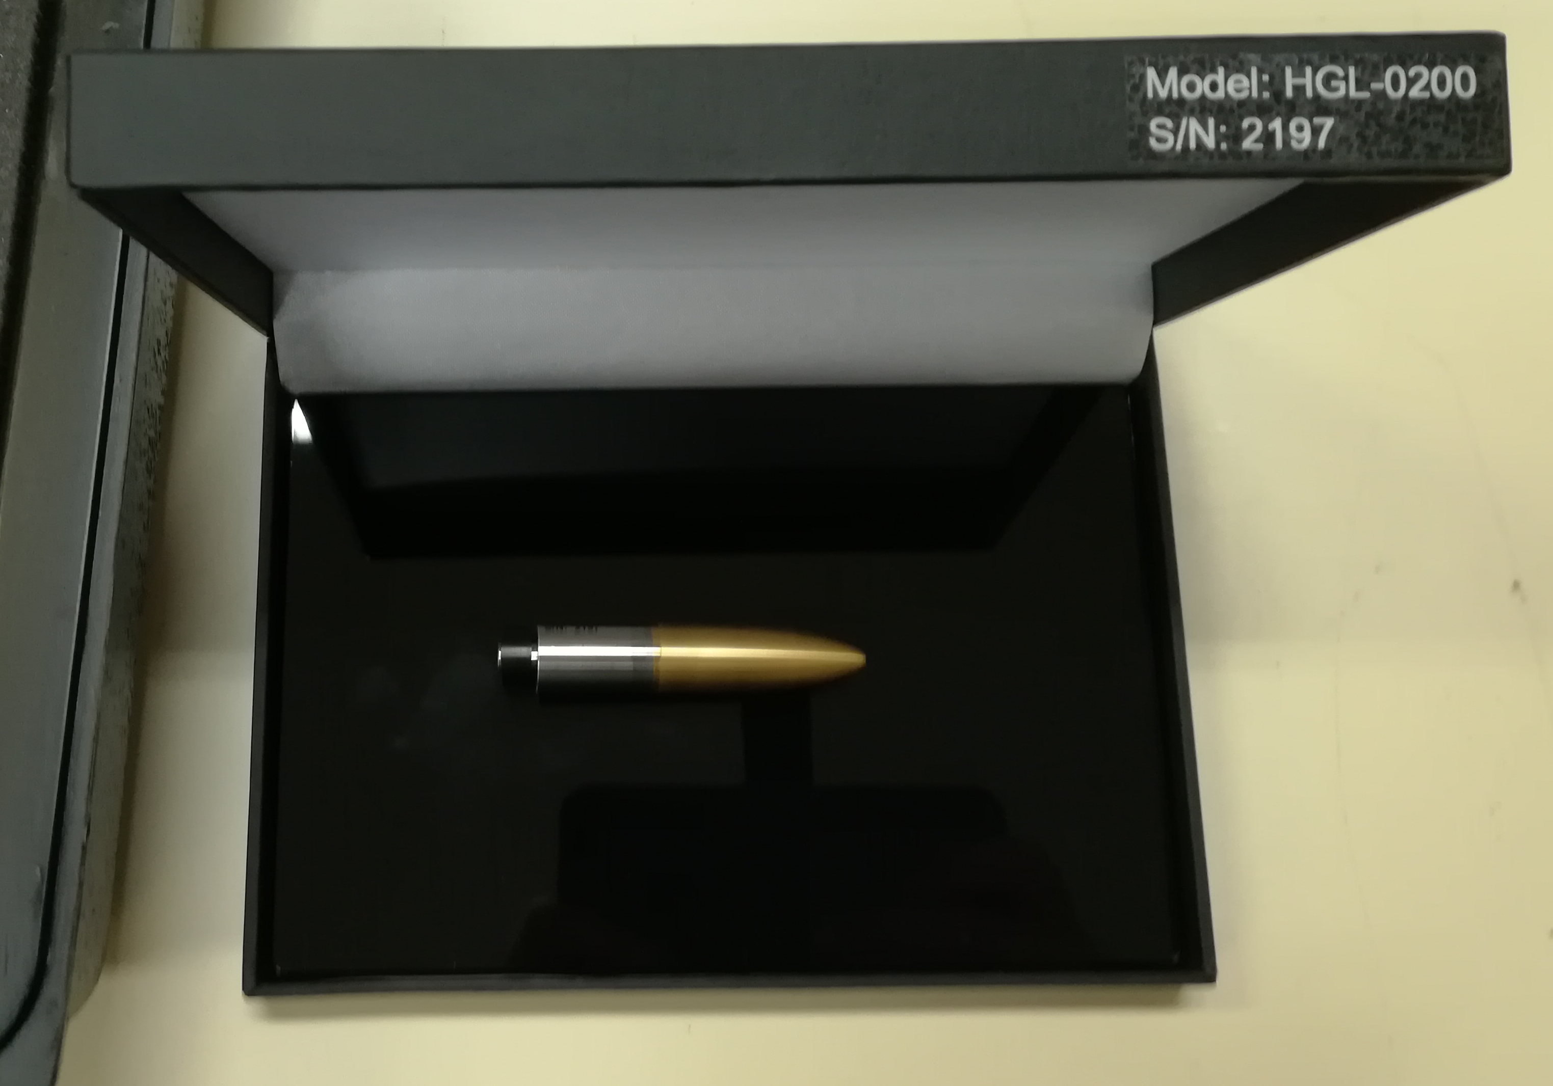
MATERIALS AND METHOD – OTHERS DEVICES
This experimental setup could be used with any hydrophone. For this setup, a calibrated capsule hydrophone from Onda (USA) is used:
Capsule -> more ruggedness than needle or membrane
Diameter 200 µm :
Intermediate sensibility : -265 [dB] re 1V/µPa
High directivity : to measure the maximum of elements contribution
Precision < pitch of probes elements
band pass from 1 MHz to 20 MHz : a large panel of frequencies could be tested

Slide 19
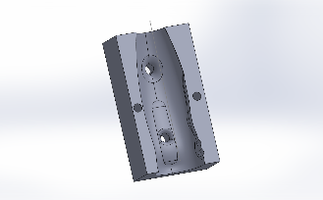
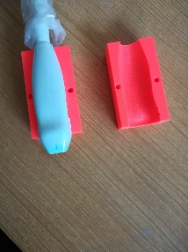
MATERIALS AND METHOD – OTHERS DEVICES
Software :
Labview : to control the hydrophone displacements and the acquisition of the hydrophone signals by an oscilloscope.
Matlab : to evaluate the safety indexes from the data acquired.
Probe holders :
CAO file
Holder printed

Slide 20
MATERIALS AND METHOD - ALIGNMENT
Step 1 : visualization of the hydrophone on the ultrasound scanner and first placement in the center of the probe
Step 2 : A 1D scan performed in the lateral and elevation directions to check the alignment and add, if necessary, an additional length of acquisition in either direction.
Step 3 : realization of a C-scan near the probe and at the depth of interest to control the third misalignment angle.

Slide 21
ALIGNMENT

Slide 22
RESULTS – UNCERTAINTIES
Sources of error :
Hydrophone measures uncertainty : ± 1 dB
Oscilloscope measures uncertainty
BNC cable error : neglected
Error positioning of the motor stage : <25µm / 100 mm
Quality of the water (not filtered and degassed) : risk of cavitation for pressure > 1 MPa
Integral calculation under MATLAB software by the trapezium method
Commercial systems must certainly present the same sources of error
Added directly during the conversion between voltage and pressure to have the worst case
The measurement should be repeated several times in order to know the overall error percentage

Slide 23
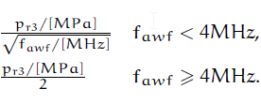
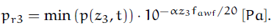
Mechanical Index (MI)
With :
f_{awf} : arithmetic-mean acoustic-working frequency
With :
Z₃ : cf slide 10
α = 3.10-5 dB/(m Hz) : acoustic attenuation coefficient
Notes:
arithmetic mean of the most widely separated frequencies f1 and f2, within the range of three
times f1, at which the magnitude of the acoustic pressure spectrum is 3 dB below the peak
magnitude

Slide 24
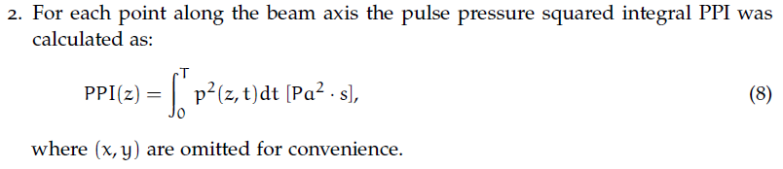
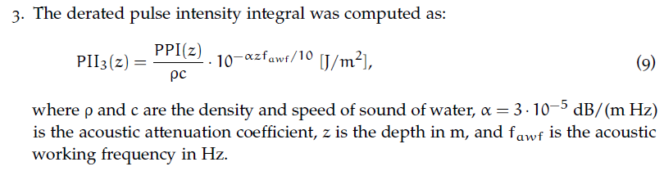
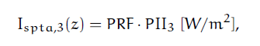
ISPTA

Slide 25
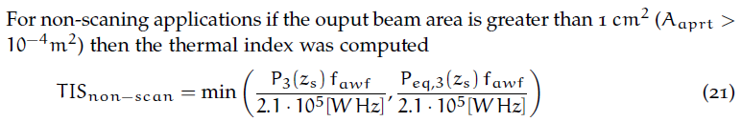
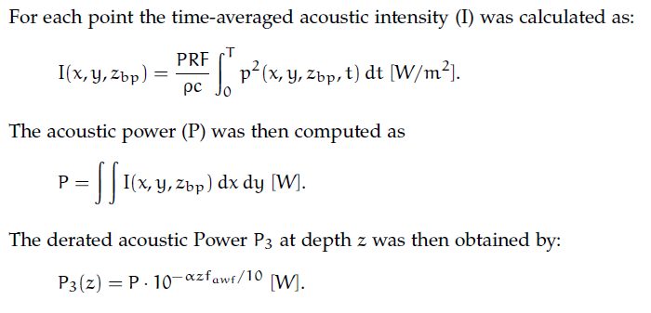
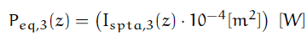
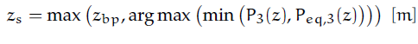
TIS for non scanning application

Slide 26
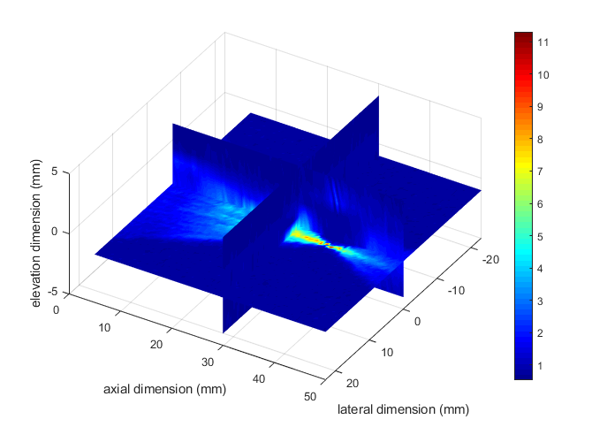
Results in focalization
Acquisition of the complete pressure field
Pressure field of a focalized sequence in MPa
Dimension | Length (mm) | Step (mm)
Axial | 45 | 0.5
Lateral | 46 | 0.5
Elevation | 8 | 0.5
Focused sequence at 35 mm with a Vantage 256 (Verasonics, USA) and a linear probe L7-4 :
Frequency | Number of cycle | Voltage | Frame rate
5.2 MHz | 1 | 50 V | 500 Hz

Slide 27
RESULTS – SAFETY INDEX
 | Standard (non scanning procedure) | Complete Field
ISPTA in mW/cm² | 122 | 171
MI | 1.3 | 1.6
TIS / TIB | 0.1/ 0.9
Thresholds given by the FDA regulation [7] for the peripheral vessels:
ISPTA < 720 mW/ cm²
MI < 1.9
[7] U. S. Food and D. Administration, ‘Information for manufacturers seeking marketing clearance of diagnostic ultrasound systems and transducers’, Rockv. MD Cent. Devices Radiol. Health US Food Drug Adm., 2008.

Slide 28
More results - MI
Method | Standard | Complete field
MI | 1.3 | 1.6
Elevation position | 5th plan | 4th plan
Axial position | 17 mm | 36,5 mm
Lateral position | -2 mm | -3 mm
Min pressure (along the beam axis) | -4,07 Mpa at 18,5 mm depth | -6,22 Mpa
Min pressure at z3 | -3,56 MPa | Not concerned
*Error on the proceeding

Slide 29
More results - ISPTA
Method | Standard | Complete field
ISPTA mW/cm² | 122 | 171
Elevation position | 5th plan | 4th plan
Axial position | 17 mm (=z3) | 36,5 mm
Lateral position | -1,5 mm | 2mm
Pressure corresponding to the max ISPTA | 7,2 Mpa (along the beam axis and at z3) | 11,2 Mpa
Max pressure | Idem like ISPTA | 11,3 Mpa at 37,5 mm depth and 2,5 mm in lateral

Slide 30
Solutions to explored to decrease the number of acquisitions
Solution 1 : Acquire only the necessary data according to the procedure of the standards -> risk : not taking into account the real maximum of the pressure field
Solution 2 : Optimize the size of the field acquired with an iterative process
Solution 3 : Find the maximum pressure using a gradient algorithm.

Slide 31
Pourquoi le max d’ISPTA ne correspond pas au max de pression?
Max d’ISPTA : pressure(:,31,36,5)
Max de pression : pressure(:,33,36,5)
PPI = 2.8536e+06
PII3= 0.9034
On multiplie PPI par 10^(-alpha*pas_ax(31)*0.001*fawf/10), soit par 0.4875
PPI = 2.9528e+06
PII3= 0.9018
On multiplie PPI par 10^(-alpha*pas_ax(31)*0.001*fawf/10), soit par 0.4703
Cela vient du terme en 10^ car le max de pression est un peu plus profond

